Slide 1


Chaos Engineering What is it, where did it come from, and where might it be going?
Adrian Cockcroft
@adrianco
AWS VP Cloud Architecture Strategy

Slide 2
What should your system do when something fails?
Stop?
Carry on with reduced functionality?

Slide 3
What should your system do when something fails?
Permissive failure, what’s the real cost of continuing?
If a permissions look up fails, should you stop or continue?
See Memories, Guesses, and Apologies by Pat Helland

Slide 4
If a permissions look up fails, should you stop or continue?
Do you have a backup datacenter?
How often do you failover apps to it?
How often do you failover the whole datacenter at once?
“Availability Theater”

Slide 5
A fairy tale…
Once upon a time, in theory, if everything works perfectly, we have a plan to survive the disasters we thought of in advance.
How did that work out?

Slide 6
Forgot to renew domain name…
SaaS vendor
Entertainment site
Didn’t update security certificate and it expired…
Datacenter flooded in hurricane Sandy…
Finance company, Jersey City
Whoops!
YOU, tomorrow

Slide 7
“You can’t legislate against failure, focus on fast detection and response.”
—Chris Pinkham

Slide 8

Synoptic Illegibility
If you can’t write down exactly what really happens, (can’t write a synopsis) you can’t automate an ad-hoc and messy system.
The Safety Anarchist Sydney Decker

Slide 9
What is supposed to happen when part of the system fails?
How is it supposed to recover after the failure goes away?

Slide 10

The Network Is Reliable ACM Queue 2014
Bailiss & Kingsbury
@pbailiss @aphyr
(Spoiler – it isn’t…)

Slide 11
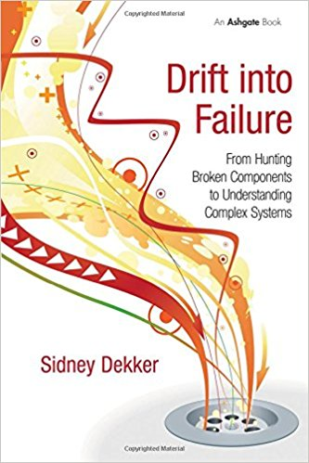
Drift Into Failure
Sydney Dekker
Everyone can do everything right at every step, and you may still get a catastrophic failure as a result…

Slide 12
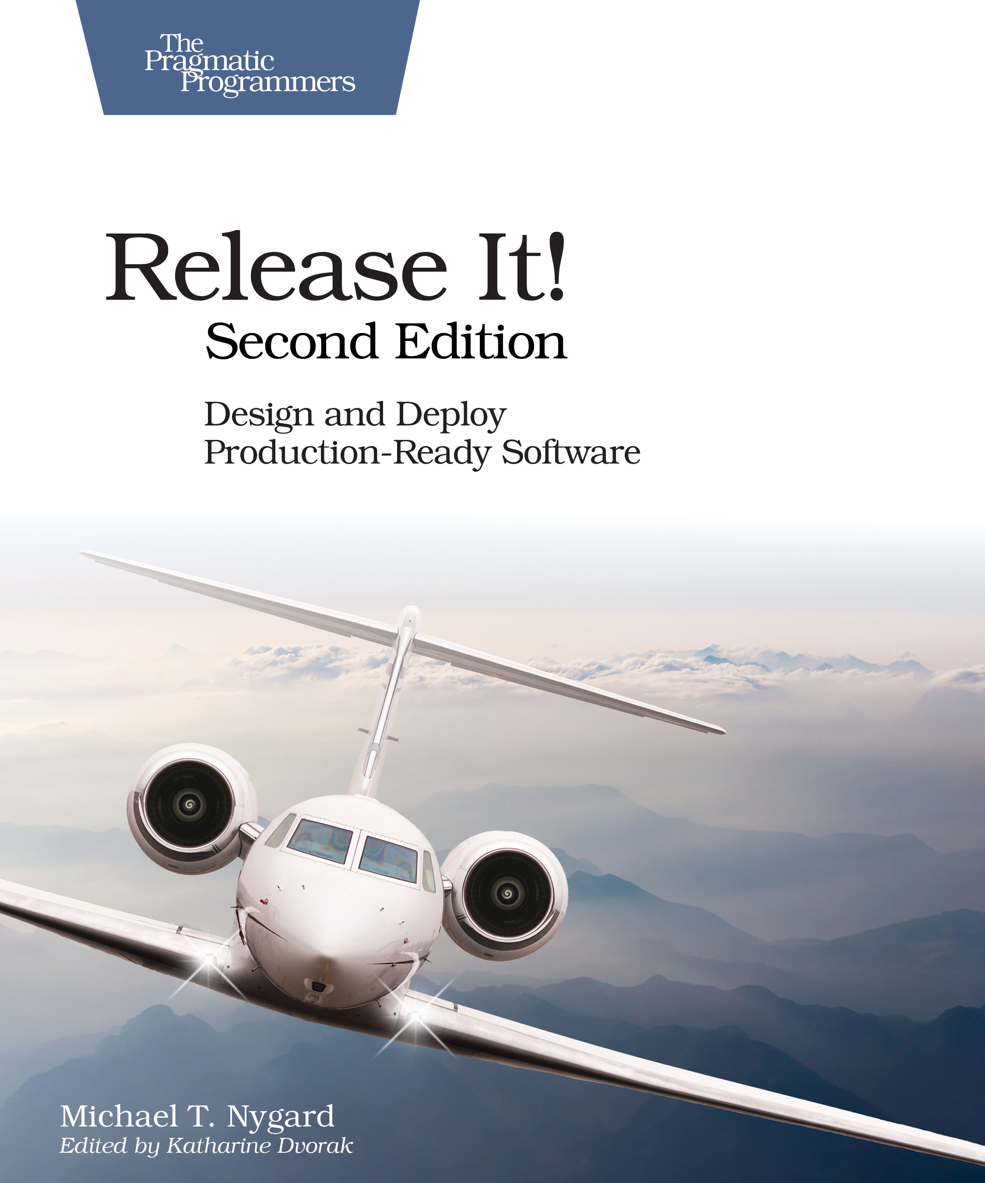
Release It! Second Edition 2017
Michael Nygard
Bulkheads, circuit breakers, and some new ideas…

Slide 13
Any sufficiently complicated C or Fortran program contains an ad-hoc, informally specified, bug ridden, slow implementation of half of common lisp.
—Philip Greenspun 1993
Greenspun’s tenth rule*
* There are, in fact, no preceding rules 1 to 9.

Slide 14
Developers love to reinvent things from first principles,
but some historical context and domain knowledge can help illuminate the path and obstacles

Slide 15
Chaos engineering is the discipline of experimenting on a distributed system in order to build confidence in the systems capacity to withstand turbulent conditions in production
Principles of Chaos Engineering

Slide 16
Chaos engineering is the discipline of experimenting on a distributed system in order to build confidence in the systems capacity to withstand turbulent conditions in production
experimenting
build confidence
capacity to withstand turbulent conditions
Principles of Chaos Engineering

Slide 17
Experiment
experimenting
to ensure that
build confidence
The impact of failure is mitigated
capacity to withstand turbulent conditions

Slide 18
Failures
What went wrong?
What kind of thing failed

Slide 19
Failures
Impacts
What are the effects of the failure?
What mitigation mechanisms are in place?

Slide 20
You can only be as strong as your weakest link
How can we try to think of everything that might fail?

Slide 21
Common language, terminology, and definitions help mitigate communication failure between people working on resiliency.
Taxonomy of failures
Taxonomy
I’m proposing some terminology, try to use common definitions rather than making up your own!
failure layers

Slide 22
Operations
Taxonomy of failures
Taxonomy
Application
Failure layers
Software stack
Infrastructure
failures

Slide 23
Operations
Application
Software Stack
a
Device failures Disk, power supply, cabling, circuit board, firmware
Taxonomy of failures
Taxonomy
CPU failures Cache corruption, logic bugs
Infrastructure
Datacenter failures Power, connectivity, cooling, fire, flood, wind, quake
failures
Internet failures DNS, ISP, internet routes

Slide 24
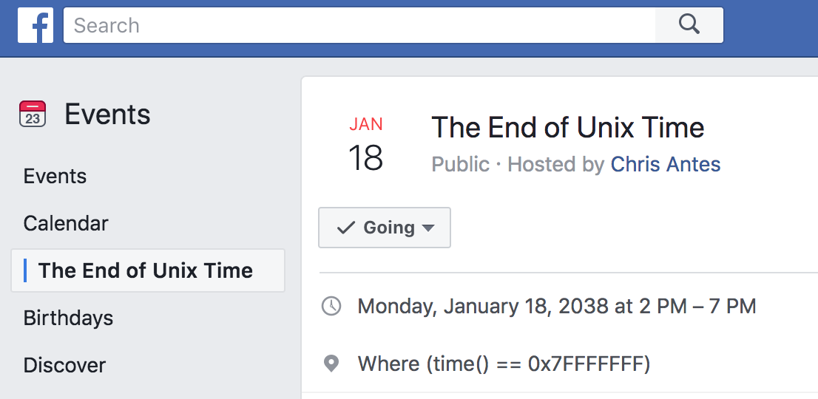
Device failures Disk, power supply, cabling, circuit board, firmware
CPU failures Cache corruption, logic bus
Datacenter failures Power, connectivity, cooling, fire, flood, wind
Routing failures DNS, ISP, internet routes
Taxonomy of failures
Taxonomy
Time bombs Counter wrap round, memory leak
End of Unix Time
Date bombs Leap year, leap second, epoch
infrastructure
Software stack
failures

Slide 25
Time bombs Counter wrap round, memory leak
Date bombs Leap year, leap second, epoch
End of Unix Time
Expiration Certificates timing out
Taxonomy of failures
Taxonomy
Revocation License or account shut down by supplier
Software stack
failures
Exploit Security failures e.g. Heartbleed

Slide 26
Expiration Certificates timing out
Revocation License or account shut down by supplier
Exploit Security failures e.g., Heartbleed
Language bugs Compiler, interpreter
Taxonomy of failures
Taxonomy
Runtime bugs JVM, Docker, Linux, Hypervisor
Software stack
failures
Protocol problems Latency dependent or poor error recovery

Slide 27
Language bugs compiler, interpreter
Runtime bugs JUM, Docker, Linux, Hypervisor
Protocol problems Flaky network protocols
Time bombs (in application code) Counter wrap round, memory leak
Taxonomy of failures
Taxonomy
Date bombs (in application code) Leap year, leap second, epoch, Y2K
software stack
Application
failures
Content bombs Data dependent failures

Slide 28
Time bombs Counter wrap round, memory leak
Date bombs Leap year, leap second, epoch
Content bombs Data dependent failures
A Netflix movie synopsis for a Spanish title contained a cedilla—Ç—encoded as <&#231;>, but was missing the >.
Taxonomy of failures
Taxonomy
Each time the title was shown, the presentation tier code entered an infinite loop; gradually taking down the site.
software stack
Application
failures
Code for the bug was six years old.

Slide 29
A Netflix movie synopsis for a Spanish title contained a cedilla—Ç—encoded as <&#231;>, but was missing the >.
Each time the title was shown, the presentation tier code entered an infinite loop; gradually taking down the site.
Code for the bug was six years old.
Taxonomy of failures
Configuration Wrong config or bad syntax
Taxonomy
Application
Versioning Incompatible mixes
failures

Slide 30
Configuration Wrong confix or bad syntax
Versioning Incompatible mixes
Cascading failures Error handling bugs
Taxonomy of failures
Taxonomy
Cascading overload Excessive logging, lock contention, hysteresis
Application
Retry Storms Too many retries, work amplification, bad timeout strategy
failures

Slide 31
Cascading failures Error handling bugs
Cascading overload Excessive logging histories, lock contention
Retry Storms Too many retries work amplification, bad timeout strategy
Poor capacity planning
Inadequate incident management
Taxonomy of failures
Taxonomy
Failure to initiate incident
application
Operations
Unable to access monitoring dashboards
failures
Insufficient observability of systems
Incorrect corrective actions

Slide 32
Resilience
1978 Sunguard—Mainframe batch
Mitigation Layers
Application level replication
Structured database replication
?
Storage block level replication
Chaos engineering
Business and safety critical systems
,
RPO
RTO
Business continuity Resilience
Recovery
Contingency
ISO 22301:2012
Societal security BCM
ISO 27031:2011 Infosec
Disaster recovery

Slide 33
Resilience
Past
Present
Future

Slide 34
Resilience
Past
Present
Future
?
Disaster recovery
Chaos engineering
Resilient
critical systems

Slide 35
Resilience
1978 Sunguard—Mainframe batch
RPO
Recovery Point Objective Time interval between recovery point snapshots; e.g., daily backups
?
RTO
Disaster recovery
Recovery Time Objective Time taken to recover after a failure; e.g., time to locate and restore from a backup
Chaos engineering
Business and safety critical systems

Slide 36
1978 Sungard—Mainframe batch
,
RPO
RTO
Business continuity Resilience
Recovery
Contingency
ISO 22301:2012 Societal security BCM (Glossary)
ISO 27031:2011 Infosec
Disaster recovery

Slide 37
Resilience
2004
2010
2012
2016
2017
2018
Layers
Request level replication
2004
Amazon—Jesse Robbins. Master of disaster
2010
Netflix—Greg Orzell. @chaosimia - First implementation of Chaos Monkey to enforce use of auto-scaled stateless services
?
Structured data
2012
NetflixOSS open sources simian army
2016
Gremlin Inc founded
Chaos engineering
2017
Netflix chaos eng book. Chaos toolkit open source project
Business and safety critical systems
Storage block
2018
Chaos concepts getting adopted widely, and this conference!

Slide 38
Chaos architecture
Four layers
Two teams
An attitude

Slide 40
Infrastructure and services
No single point of failure

Slide 41
Infrastructure

Slide 43

Switching and interconnecting
Data replication
Traffic routing
Avoiding issues
Anti-entropy recovery

Slide 44
Switching and interconnecting
Data replication
Traffic routing
Avoiding issues
Anti-entropy recovery

Slide 45
Switching and interconnecting
Data replication
Traffic routing
Avoiding issues
Anti-entropy recovery

Slide 46
Switching
Infrastructure

Slide 48
!
Application
failures
App
Error returns
Slow response
Network partition

Slide 49
Application
Switching
Infrastructure

Slide 51
People
Whoops!
I wonder why it did that?
Let’s reboot it.
Now it’s really hosed
Unexpected application behavior often causes people to intervene and make the situation worse

Slide 52
People training
!
A fire drill is a boring routine where we make everyone take the stairs and assemble in the parking lot

Slide 53
People training
Fire drills save lives in the event of a real fire, because people are trained how to react

Slide 54
People
Who runs the “fire drill” for I.T.?
Application
Switching
Infrastructure

Slide 55
People
Application
Chaos Engineering Team
Switching
Infrastructure

Slide 56
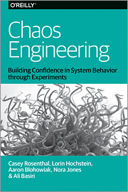
People
Application
Chaos Engineering Team
Switching
Infrastructure

Slide 57
People
Application
Tools
Chaos Engineering Team
Switching
Infrastructure

Slide 58


Tools
Game days
People
Simian Army
Application
chaostoolkit
Chaos Engineering Team
Switching
ChAP
Gremlin
Infrastructure

Slide 59
People
Application
Tools
Chaos Engineering Team
Switching
Security Red Team
Infrastructure

Slide 60
People
Application
Tools
Tools
Chaos Engineering Team
Switching
Security Red Team
Infrastructure

Slide 61
Tools
People
Safestack AVA
Infection
Monkey
Application
Tools
Chaosslingr
Chaos Engineering Team
Switching
Security Red Team
AttackIQ
Infrastructure
SafeBreach

Slide 62
Chaos
architecture
People
Application
Four layers
Two teams
An attitude— Break it to make it better
Tools
Tools
Chaos Engineering Team
Switching
Security Red Team
Infrastructure

Slide 63
Break it to make it safer
The “New View” of Safety based on:
Todd Conklin’s Pre-accident podcast
John Allspaw’s stella.report
Sydney Dekker—Drift into Failure

Slide 64
Failures are a system problem— lack of safety margin
Not something with a root cause of component or human error

Slide 65
Blindfolded on a cliff edge, what would you do?

Slide 66
Hypothesis testing
We think we have safety margin in this dimension, let’s carefully test to be sure
In production
Without causing an issue

Slide 67
Experienced staff
Robust applications
Dependable switching fabric
Redundant service foundation

Slide 68


?
Possible future directions
Observability of systems
Epidemic failure modes
Automation and continuous chaos

Slide 69
?
Possible future directions
Observability of systems
Epidemic failure modes
Automation and continuous chaos

Slide 70
“OMG a new term that we should be defining and arguing about…”
Kalaman, 1961 paper On the general theory of control systems
A system is observable If the behavior of the entire system can be determined by only looking at its inputs and outputs
Observability
Epidemic failure modes
Automation and continuous chaos
Lesson: Control theory is a thing people should learn about rather than try to reinvent…

Slide 71
DevOps But no one ever talked about observability of computers before?
Cockcroft & Walker, 2001 Capacity Planning For Web Services. Entire chapter on observability which wasn’t controversial at the time
Lesson Control theory is a thing people should learn about rather than reinvent…
Function with no side effects
High
Microservice that does one thing
Medium
Observability
Monolith with tracing and logging
Low
Monolith with logging

Slide 72

Failures can be
Independent Common assumption
Correlated Harder to model and mitigate knock-on effects
Epidemic Everything breaks at once!
examples

Slide 73
Failures can be
Linux Leap—second bug
Sun SPARC cache bit-flip
Cloud zone or region failure
DNS failure
Security configuration syntax error
Epidemic
Independent Common assumption
Correlated Harder to model and mitigate knock-on effects
examples

Slide 74
Linux Leap—second bug
Sun SPARC cache bit-flip
Cloud zone or region failure
DNS failure
Security configuration syntax error
Epidemic
examples
Quarantine needed

Slide 75
Linux Leap—second bug Maintain ability to deploy on Windows
Sun SPARC cache bit-flip Use a variety of CPU implementations
Cloud zone or region failure Cross-zone or region replication
DNS failure Multiple domains and providers
Security configuration syntax error Limit the scope of deployments
Epidemic
examples
Quarantine
Diversity needs to be managed to contain an epidemic

Slide 76
Linux Leap—second bug Maintain ability to deploy on Windows
Sun SPARC cache bit-flip Use a variety of CPU implementations
Cloud zone or region failure Cross-zone or region replication
DNS failure Multiple domains and providers
Security configuration corruption Limit scope of deployments
Epidemic
examples
Quarantine
Diversity needs to be managed to contain an epidemic

Slide 77
Cloud Native Chaos in Practice
Mechanisms for AWS and Kubernetes

Slide 78

No global network or service dependencies
completely independent regions
Regions made up of availability zones
Zones between 10–100km apart
Separate flood planes, electric supply etc.
Close enough for synchronous replication
AWS Isolation Model

Slide 79
Zones made up of datacenter buildings
Datacenters divided internally to isolate and replicate critical services
Redundant private network around the world
AWS Isolation Model

Slide 80
AWS Mechanisms
Amazon Aurora DB Cluster Fault Injection Queries
Crash master or replica
Fail a replica
Disk failure or congestion
ALTER SYSTEM SIMULATE percentage_of_failure PERCENT READ REPLICA FAILURE [ TO ALL | TO "replica name" ] FOR INTERVAL quantity { YEAR | QUARTER | MONTH | WEEK | DAY | HOUR | MINUTE | SECOND };
https://docs.aws.amazon.com/AmazonRDS/latest/UserGuide/AuroraMySQL.Managing.FaultInjectionQueries.html

Slide 81
AWS Mechanisms
IAM Region Restriction
Simulate regional API issues by changing the list of permitted regions
{ "Sid": "RegionRestricted", "Effect": "Allow", "Action": “*”, "Resource": "*", "Condition": {"StringEquals": {"aws:RequestedRegion": [ "eu-west-1"]}}
}
https://aws.amazon.com/blogs/security/easier-way-to-control-access-to-aws-regions-using-iam-policies/

Slide 82
Kubernetes Mechanisms
Gremlin Inc. Attacks
Gremlin runs a daemon on each node that manages and induces failures and network blocking
https://www.gremlin.com/community/tutorials/how-to-install-and-use-gremlin-with-kubernetes/

Slide 83
Kubernetes Mechanisms
Open Source Chaos Toolkit
Chaos Toolkit defines experiments, executes them and generates reports – chaostoolkit.org
Drivers for Gremlin, EC2 and Kubernetes etc.
Included in Kubernetes on AWS Workshop
https://medium.com/chaos-toolkit/make-applications-more-resilient-on-kubernetes-by-adding-chaos-engineering-70a4c282609f

Slide 84
CNCF Chaos Working Group
Open Source Chaos Toolkit
Use EC2 driver to impact k8s control plane
Use k8s driver to impact applications
Introduction https://medium.com/chaosiq/a-pinch-of-chaos-engineering-at-kubecon-604614b73871
Image from https://kubecloud.io/ha-kubernetes-cluster-on-aws-kops-makes-it-easy-2337806d0311

Slide 85
Cloud provides the automation that leads to chaos engineering

Slide 86
As datacenters migrate to cloud, fragile and manual disaster recovery will be replaced by chaos engineering

Slide 87

Testing failure mitigation will move from a scary annual experience to automated continuous chaos

Slide 88
Thanks for listening!
Please let AWS know what we can do to help you prove that your systems are resilient

Slide 89
Chaos Engineering What is it, where did it come from, and where might it be going?
Adrian Cockcroft
@adrianco
AWS VP Cloud Architecture Strategy

